Slide 1

FPT University
Android programMing
Lesson 16
Version 1.0

Slide 2
Agenda
SQLite Databases
Android TableLayout and TableRow
Android Content Providers

Slide 3
SQLite Databases
The use of databases is an essential aspect of most applications, ranging from applications that are almost entirely data driven, to those that simply need to store small amounts of data such as the prevailing score of a game

Slide 4
SQLite Databases
Understanding Database Tables
Database Tables provide the most basic level of data structure in a database. Each database can contain multiple tables and each table is designed to hold information of a specific type
Each table in a database is assigned a name that must be unique within that particular database. A table name, once assigned to a table in one database

Slide 5
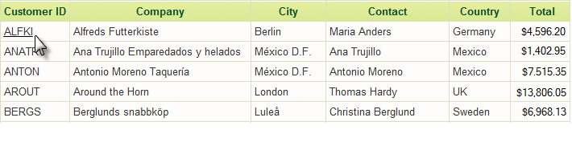
SQLite Databases
Example of Database Table

Slide 6
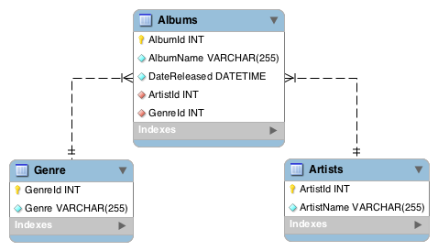
SQLite Databases
Database Schema
Database Schemas define the characteristics of the data stored in a database table
Schemas are also used to define the structure of entire databases and the relationship between the various tables contained in each database.
Notes:
For example, the table schema for a Albums database table might define that the album name is a string of no more than 255 characters in length, and that the release date is a date time format

Slide 7
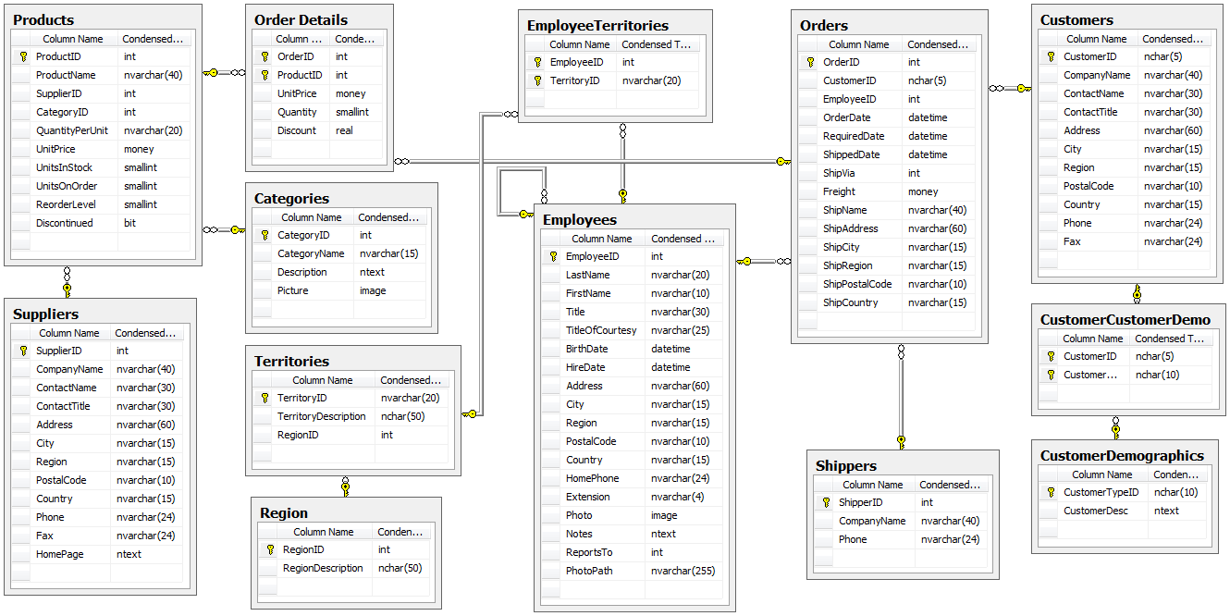
Northwind Database

Slide 8
SQLite Databases
Columns and Data Types
It is helpful at this stage to begin to view a database table as being similar to a spreadsheet where data is stored in rows and columns.
Each column represents a data field in the corresponding table. For example, the name, address and telephone data fields of a table are all columns.
Each column, in turn, is defined to contain a certain type of data. A column designed to store numbers would, therefore, be defined as containing numerical data.

Slide 9
SQLite Databases
Database Rows
Each new record that is saved to a table is stored in a row. Each row, in turn, consists of the columns of data associated with the saved record.
Rows are also sometimes referred to as records or entries and these terms can generally be used interchangeably

Slide 10
SQLite Databases
Primary Keys
Each database table should contain one or more columns that can be used to identify each row in the table uniquely. This is known in database terminology as the Primary Key
Primary keys can comprise a single column or multiple columns in a table. To qualify as a single column primary key, no two rows can contain matching primary key values.

Slide 11
SQLite Databases
What is SQLite? SQLite is an embedded, relational database management system (RDBMS). SQLite is referred to as embedded because it is provided in the form of a library that is linked into applications. As such, there is no standalone database server running in the background. All database operations are handled internally within the application through calls to functions contained in the SQLite library.

Slide 12
SQLite Databases
SQLite is written in the C programming language and as such, the Android SDK provides a Java based “wrapper” around the underlying database interface. This essentially consists of a set of classes that may be utilized within the Java code of an application to create and manage SQLite based databases.

Slide 13
SQLite Databases
Structured Query Language (SQL) Data is accessed in SQLite databases using a high-level language known as Structured Query Language. SQL is a standard language used by most relational database management systems. SQLite conforms mostly to the SQL-92 standard.
Notes:
https://en.wikipedia.org/wiki/SQL-92

Slide 14
SQLite Databases
Trying SQLite on an Android Virtual Device (AVD)
Starting and AVD for testing
Using ADB tool
Notes:
ADB root not working
https://stackoverflow.com/questions/43923996/adb-root-is-not-working-on-emulator/45668555
Steps: To install and use an emulator image that can run as root:
In Android Studio, use the menu command Tools > AVD Manager.
Click the +Create Virtual Device... button.
Select the virtual Hardware.
Select the System Image. Pick any of these:
Intel x86 Atom System Image
Intel x86 Atom_64 System Image
Google APIs Intel x86 Atom System Image
Google APIs Intel x86 Atom_64 System Image.
(Do NOT pick "Google Play ... System Image". Those are the ones that cannot run as root.)
Click the Download button if needed.
Finish creating your new AVD.
Run your new AVD.

Slide 15
SQLite Databases
Trying som SQLite command
adb –e shell cd /data/data mkdir com.example.dbexample cd com.example.dbexample mkdir databases cd databases sqlite3 ./mydatabase.db create table contacts (_id integer primary key autoincrement, name text, address text, phone text); .tables insert into contacts (name, address, phone) values ("Bill Smith", "123 Main Street, California", "123-555-2323"); insert into contacts (name, address, phone) values ("Mike Parks", "10 Upping Street, Idaho", "444-444-1212"); select * from contacts; select * from contacts where name="Mike Parks"; .exit
Notes:
ADB root not working
https://stackoverflow.com/questions/43923996/adb-root-is-not-working-on-emulator/45668555
Steps: To install and use an emulator image that can run as root:
In Android Studio, use the menu command Tools > AVD Manager.
Click the +Create Virtual Device... button.
Select the virtual Hardware.
Select the System Image. Pick any of these:
Intel x86 Atom System Image
Intel x86 Atom_64 System Image
Google APIs Intel x86 Atom System Image
Google APIs Intel x86 Atom_64 System Image.
(Do NOT pick "Google Play ... System Image". Those are the ones that cannot run as root.)
Click the Download button if needed.
Finish creating your new AVD.
Run your new AVD.

Slide 16
Android SQLite Java Classes
SQLite is written in the C programming language while Android applications are primarily developed using Java. To bridge this “language gap”, Android SDK includes a set of classes that provide a Java layer on top of the SQLite database management system

Slide 17
Android SQLite Java Classes
Cursor A class provided specifically to provide access to the results of a database query · close() – Releases all resources used by the cursor and closes it. · getCount() – Returns the number of rows contained within the result set. · moveToFirst() – Moves to the first row within the result set. · moveToLast() – Moves to the last row in the result set. · moveToNext() – Moves to the next row in the result set. · move() – Moves by a specified offset from the current position in the result set. · get<type>() – Returns the value of the specified <type> contained at the specified column index of the row at the current cursor position (variations consist of getString(), getInt(), getShort(), getFloat() and getDouble()).

Slide 18
Android SQLite Java Classes
SQLiteDatabase This class provides the primary interface between the application code and underlying SQLite databases including the ability to create, delete and perform SQL based operations on databases. Some key methods of this class are as follows: · insert() – Inserts a new row into a database table. · delete() – Deletes rows from a database table. · query() – Performs a specified database query and returns matching results via a Cursor object. · execSQL() – Executes a single SQL statement that does not return result data. · rawQuery() – Executes a SQL query statement and returns matching results in the form of a Cursor object.

Slide 19
Android SQLite Java Classes
SQLiteOpenHelper
A helper class designed to make it easier to create and update databases. This class must be subclassed within the code of the application seeking database access and the following callback methods implemented within that subclass:
· onCreate() – Called when the database is created for the first time. This method is passed the SQLiteDatabase object as an argument for the newly created database. This is the ideal location to initialize the database in terms of creating a table and inserting any initial data rows.
· onUpgrade() – Called in the event that the application code contains a more recent database version number reference. This is typically used when an application is updated on the device and requires that the database schema also be updated to handle storage of additional data.

Slide 20
Android SQLite Java Classes
SQLiteOpenHelper
· getWritableDatabase() – Opens or creates a database for reading and writing. Returns a reference to the database in the form of a SQLiteDatabase object. · getReadableDatabase() – Creates or opens a database for reading only. Returns a reference to the database in the form of a SQLiteDatabase object. · close() – Closes the database.

Slide 21
Android SQLite Java Classes
ContentValues ContentValues is a convenience class that allows key/value pairs to be declared consisting of table column identifiers and the values to be stored in each column. This class is of particular use when inserting or updating entries in a database table.

Slide 22
TableLayout and TableRow
The purpose of the TableLayout container view is to allow user interface elements to be organized on the screen in a table format consisting of rows and columns

Slide 23
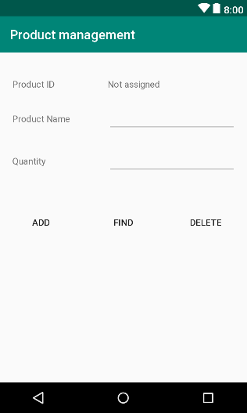
TableLayout and TableRow
Creating the Database Project

Slide 24
TableLayout and TableRow
Adding the TableLayout to the User Interface By default, Android Studio has used a ConstraintLayout as the root layout element in the user interface. This needs to be replaced by a vertically oriented LinearLayout
<LinearLayout xmlns:android="http://schemas.android.com/apk/res/android" xmlns:tools="http://schemas.android.com/tools" android:orientation="vertical" android:layout_width="match_parent" android:layout_height="match_parent" tools:context=".DatabaseActivity"> </LinearLayout>

Slide 25
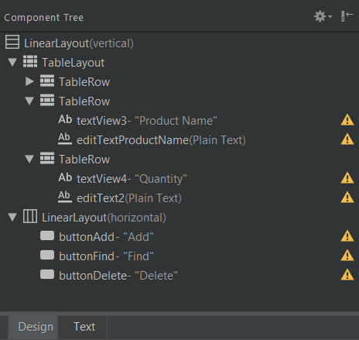
TableLayout and TableRow
Adding the widgets

Slide 26
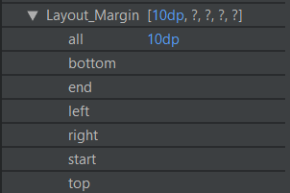
TableLayout and TableRow
Adjusting the Layout Margins
Add Layout_Margin for each table rows

Slide 27
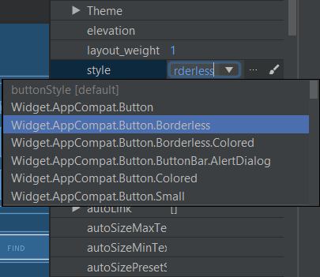
TableLayout and TableRow
Change the buttons style

Slide 28
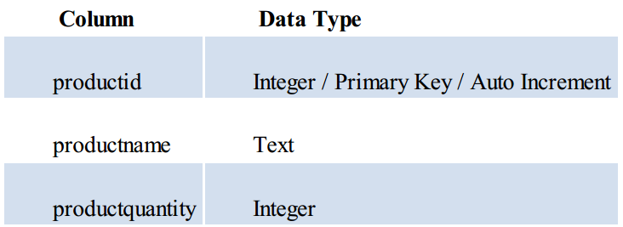
SQLite Database Example
Database Example The idea behind this application is to allow the tracking of product inventory.The name of the database will be productID.db which, in turn, will contain a single table named products

Slide 29
SQLite Database Example
Creating the Data Model
public class Product { private String id; private String name; private int quantity; public Product() {...} public Product(String name, int quantity) {...} public Product(String id, String name, int quantity) {...} public String getId() {...} public void setId(String id) {...}
...........
}

Slide 30
SQLite Database Example
Implementing the Data Handler
public class DatabaseHandler extends SQLiteOpenHelper { public DatabaseHandler(Context context, String name, SQLiteDatabase.CursorFactory factory, int version) { super(context, name, factory, version); } @Override public void onCreate(SQLiteDatabase db) { } @Override public void onUpgrade(SQLiteDatabase db, int oldVersion, int newVersion) { } }

Slide 31
SQLite Database Example
Adding constant value
private static final int DATABASE_VERSION = 1; private static final String DATABASE_NAME = "ProductDB.db"; private static final String TABLE_PRODUCT = "Product"; private static final String COLUMN_ID = "id"; private static final String COLUMN_NAME = "productname"; private static final String COLUMN_QUANTITY = "quantity";

Slide 32
SQLite Database Example
Implementing override methods
public class DatabaseHandler extends SQLiteOpenHelper { public DatabaseHandler(Context context, String name, SQLiteDatabase.CursorFactory factory, int version) { super(context, DATABASE_NAME, factory, DATABASE_VERSION); } @Override public void onCreate(SQLiteDatabase db) { String CREATE_PRODUCTS_TABLE = "CREATE TABLE " + TABLE_PRODUCT + "(" + COLUMN_ID + " INTEGER PRIMARY KEY, " + COLUMN_NAME + " TEXT, " + COLUMN_QUANTITY + " INTEGER)"; db.execSQL(CREATE_PRODUCTS_TABLE); } @Override public void onUpgrade(SQLiteDatabase db, int oldVersion, int newVersion) { db.execSQL("DROP TABLE IF EXIST " + TABLE_PRODUCT); onCreate(db); }
Notes:
The onUpgrade() method is called when the handler is invoked with a greater database version number from the one previously used. The exact steps to be performed in this instance will be application specific, so for the purposes of this example, we will simply remove the old database and create a new one:

Slide 33
SQLite Database Example
The Add Handler Method
public Long addProduct(Product product){ ContentValues values = new ContentValues(); values.put(COLUMN_NAME, product.getName()); values.put(COLUMN_QUANTITY, product.getQuantity()); SQLiteDatabase db = this.getWritableDatabase(); Long result = db.insert(TABLE_PRODUCT, null, values); db.close(); return result; }

Slide 34
SQLite Database Example
The Query Handler Method
public Product findProduct(String productName){ String query = "SELECT * FROM " + TABLE_PRODUCT + " WHERE " + COLUMN_NAME + " = '" + productName + "'"; SQLiteDatabase db = this.getWritableDatabase(); Cursor cursor = db.rawQuery(query, null); if(cursor.moveToFirst()){ Product product = new Product(); product.setId(cursor.getString(0)); product.setName(cursor.getString(1)); product.setQuantity(Integer.parseInt(cursor.getString(2))); db.close(); return product; } db.close(); return null; }

Slide 35
SQLite Database Example
The Delete Handler Method
public int deleteProduct(String productName){ Product product = findProduct(productName); if(product!=null){ SQLiteDatabase db = this.getWritableDatabase(); int result = db.delete(TABLE_PRODUCT, COLUMN_ID + " =?", new String[]{product.getId()}); return result; } return 0; }

Slide 36
SQLite Database Example
Implementing the Activity Event Methods
public void addOnClick(View view) { DatabaseHandler dbHandler = new DatabaseHandler(this,null,null,1); int quantity = Integer.parseInt(quantityEditText.getText().toString()); Product product = new Product(nameEditText.getText().toString(), quantity); Long result = dbHandler.addProduct(product); if(result == -1){ idTextView.setText("Add product failed"); return; } idTextView.setText("Add product success"); nameEditText.requestFocus(); quantityEditText.setText(""); }

Slide 37
SQLite Database Example
Implementing the Activity Event Methods
public void findOnClick(View view) { DatabaseHandler dbHandler = new DatabaseHandler(this,null,null,1); Product product = dbHandler.findProduct(nameEditText.getText().toString()); if(product == null){ idTextView.setText("Product not found"); } else { idTextView.setText(product.getId()); quantityEditText.setText(String.valueOf(product.getQuantity())); } }

Slide 38
SQLite Database Example
Implementing the Activity Event Methods
public void deleteOnClick(View view) { DatabaseHandler dbHandler = new DatabaseHandler(this,null,null,1); int result = dbHandler.deleteProduct(nameEditText.getText().toString()); if(result!=0) idTextView.setText("Product is deleted"); else idTextView.setText("Product not found"); }

Slide 39
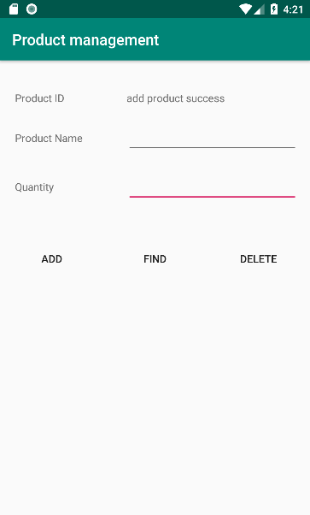
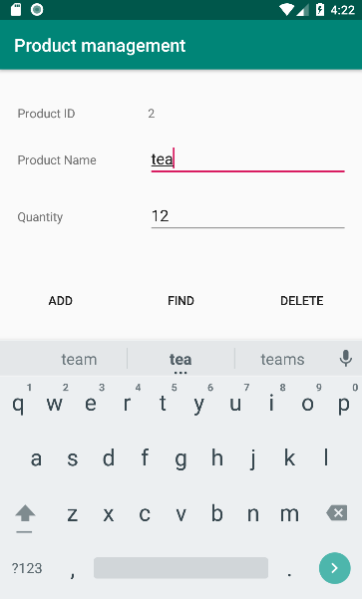
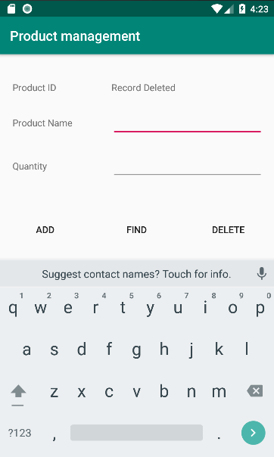
SQLite Database Example
Testing application

Slide 40
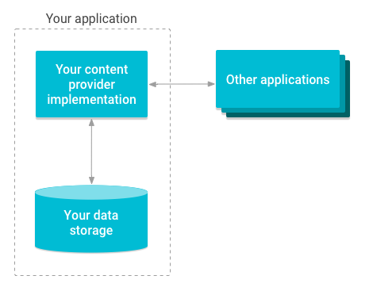
Android Content Providers
What is a Content Provider? A content provider provides access to structured data between different Android applications. This data is exposed to applications either as tables of data or as a handle to a file
Notes:
The previous chapter worked through the creation of an example application designed to store data using a SQLite database. When implemented in this way, the data is private to the application and, as such, inaccessible to other applications running on the same device. While this may be the desired behavior for many types of application, situations will inevitably arise whereby the data stored on behalf of an application could be of benefit to other applications. A prime example of this is the data stored by the built-in Contacts application on an Android device. While the Contacts application is primarily responsible for the management of the user’s address book details, this data is also made accessible to any other applications that might need access to this data. This sharing of data between Android applications is achieved through the implementation of content providers

Slide 41
Android Content Providers
The Content Provider A content provider is created as a subclass of the android.content.ContentProvider class. Typically, the application responsible for managing the data to be shared will implement a content provider to facilitate the sharing of that data with other applications. The creation of a content provider involves the implementation of a set of methods to manage the data on behalf of other, client applications.

Slide 42
Android Content Providers
onCreate() This method is called when the content provider is first created and should be used to perform any initialization tasks required by the content provider.
query() This method will be called when a client requests that data be retrieved from the content provider. It is the responsibility of this method to identify the data to be retrieved (either single or multiple rows), perform the data extraction and return the results wrapped in a Cursor object.

Slide 43
Android Content Providers
insert() This method is called when a new row needs to be inserted into the provider database. This method must identify the destination for the data, perform the insertion and return the full URI of the newly added row.
update() The method called when existing rows need to be updated on behalf of the client. The method uses the arguments passed through to update the appropriate table rows and return the number of rows updated as a result of the operation.

Slide 44
Android Content Providers
delete() Called when rows are to be deleted from a table. This method deletes the designated rows and returns a count of the number of rows deleted.
getType() Returns the MIME type of the data stored by the content provider.
Notes:
MIME stands for "Multipurpose Internet Mail Extensions. It's a way of identifying files on the Internet according to their nature and format. For example, using the "Content-type" header value defined in a HTTP response, the browser can open the file with the proper extension/plugin.

Slide 45
Android Content Providers
The Content URI An Android device will potentially contain a number of content providers. The system must provide some way of identifying one provider from another. Similarly, a single content provider may provide access to multiple forms of content
Notes:
What is URI, URL, URN?
URN = Uniform Resource Name, Name of resource but not have protocol to get it ex: index.html
URL = Uniform Resource Locator, A resource locator with protocol to get it ex: http://index.html
URI = Uniform Resource Identifier, URIs are identifiers, and that can mean a resource name by itself, or a resource name with a method of getting to it.
All URNs and URLs are URIs
|--------------------URI, URL-------------------|
|--------------URI-----------------|
|-URI, URN-|
---Schema--|--------Host---------|----Path---|
https:// www.Wikipedia.org/Index.html

Slide 46
Android Content Providers
The Authority section of the URI identifies the content provider and usually takes the form of the package name of the content provider. For example:
com.example.mydbapp.myprovider
A specific database table within the provider data structure may be referenced by appending the table name to the authority. For example
com.example.mydbapp.myprovider/products
a specific row within the specified table may be referenced by appending the row ID to the URI. For example:
com.example.mydbapp.myprovider/products/3

Slide 47
Android Content Providers
The Content Resolver Access to a content provider is achieved via a ContentResolver object. An application can obtain a reference to its content resolver by making a call to the getContentResolver() method of the application context.

Slide 48
Android Content Providers
The <provider> Manifest Element
In order for a content provider to be visible within an Android system, it must be declared within the Android manifest file for the application in which it resides. This is achieved using the <provider> element, which must contain the following items:
· android:authority – The full authority URI of the content provider. For example com.example.mydbapp.mydbapp.myprovider.
· android:name – The name of the class that implements the content provider. In most cases, this will use the same value as the authority

Slide 49
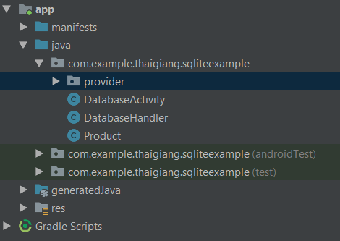
Implementing an Android Content Provider
Adding the Content Provider Package app -> New -> Package

Slide 50
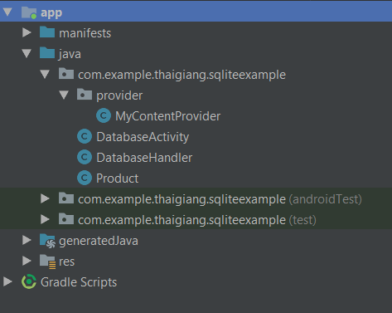
Implementing an Android Content Provider
Creating the Content Provider Class app -> New -> Other -> Content Provider

Slide 51
Implementing an Android Content Provider
Constructing the Authority and Content URI
private static final String AUTHORITY = "com.example.fu.database.MyContentProvider"; private static final String PRODUCT_TABLE = "Product"; public static final Uri CONTENT_URI = Uri.parse("content://" + AUTHORITY + "/" + PRODUCT_TABLE);

Slide 52
Implementing an Android Content Provider
Implementing URI Matching in the Content Provider
private static final int PRODUCTS = 1; private static final int PRODUCTS_ID = 2; private static final UriMatcher uriMatcher = new UriMatcher(UriMatcher.NO_MATCH); static { uriMatcher.addURI(AUTHORITY, PRODUCT_TABLE, PRODUCTS); uriMatcher.addURI(AUTHORITY,PRODUCT_TABLE + "#",PRODUCTS_ID); }

Slide 53
Implementing an Android Content Provider
Implementing onCreate() Method
private DatabaseHandler dbHandler; @Override public boolean onCreate() { dbHandler = new DatabaseHandler(getContext(),null,null,1); return false; }

Slide 54
Implementing an Android Content Provider
Implementing insert() Method
@Override public Uri insert(Uri uri, ContentValues values) { // TODO: Implement this to handle requests to insert a new row. int uriType = uriMatcher.match(uri); SQLiteDatabase db = dbHandler.getWritableDatabase(); long id = 0; switch (uriType){ case PRODUCTS: id = db.insert(DatabaseHandler.TABLE_PRODUCT,null,values); break; default: return null; } getContext().getContentResolver().notifyChange(uri, null); return Uri.parse(PRODUCT_TABLE + "/" + id); }

Slide 55
Implementing an Android Content Provider
Implementing the query() Method
@Override public Cursor query(Uri uri, String[] projection, String selection, String[] selectionArgs, String sortOrder) { // TODO: Implement this to handle query requests from clients. SQLiteQueryBuilder queryBuilder = new SQLiteQueryBuilder(); queryBuilder.setTables(PRODUCT_TABLE); int uriType= uriMatcher.match(uri); switch (uriType){ case PRODUCTS_ID: break; case PRODUCTS: break; default: throw new IllegalArgumentException("Unknown Uri:" + uri); } Cursor cursor = queryBuilder.query(dbHandler.getReadableDatabase(), projection,selection,selectionArgs,null, null, sortOrder); cursor.setNotificationUri(getContext().getContentResolver(), uri); return cursor; }

Slide 56
Implementing an Android Content Provider
Implementing the update() Method
@Override public int update(Uri uri, ContentValues values, String selection, String[] selectionArgs) { // TODO: Implement this to handle requests to update one or more rows. int uriType = uriMatcher.match(uri); SQLiteDatabase db = dbHandler.getWritableDatabase(); int rowUpdated = 0; switch (uriType){ case PRODUCTS: rowUpdated = db.update(PRODUCT_TABLE, values,selection,selectionArgs); break; case PRODUCTS_ID: String id = uri.getLastPathSegment(); if(TextUtils.isEmpty(selection)){ rowUpdated = db.update(PRODUCT_TABLE, values, DatabaseHandler.COLUMN_ID + " = " + id, null); } else { rowUpdated = db.update(PRODUCT_TABLE, values, DatabaseHandler.COLUMN_ID + " = " + id + " and " + selection, selectionArgs ); } break; default: throw new IllegalArgumentException("Unknown Uri:" + uri); } getContext().getContentResolver().notifyChange(uri, null); return rowUpdated; }

Slide 57
Implementing an Android Content Provider
Implementing the delete() Method
public int delete(Uri uri, String selection, String[] selectionArgs) { int uriType = uriMatcher.match(uri); SQLiteDatabase db = dbHandler.getWritableDatabase(); int rowDeleted = 0; switch (uriType){ case PRODUCTS_ID: String id = uri.getLastPathSegment(); if(TextUtils.isEmpty(selection)){ rowDeleted = db.delete(PRODUCT_TABLE, DatabaseHandler.COLUMN_ID + " = " + id, null); } else { rowDeleted = db.delete(PRODUCT_TABLE, DatabaseHandler.COLUMN_ID + " = " + id + " and " + selection, selectionArgs); } break; case PRODUCTS: rowDeleted = db.delete(PRODUCT_TABLE, selection, selectionArgs); break; default: throw new IllegalArgumentException("Unknown Uri: " + uri); } getContext().getContentResolver().notifyChange(uri,null); return rowDeleted; }

Slide 58
Implementing an Android Content Provider
Declaring the Content Provider in the Manifest File
<provider android:name=".provider.MyContentProvider" android:authorities="com.example.fu.database.MyContentProvider" android:enabled="true" android:exported="true"> </provider>

Slide 59
Modifying the Database Handler
Adding content resolver
private ContentResolver contentResolver; public DatabaseHandler(Context context, String name, SQLiteDatabase.CursorFactory factory, int version) { super(context, DATABASE_NAME, factory, DATABASE_VERSION); contentResolver = context.getContentResolver(); }

Slide 60
Modifying the Database Handler
Modifying addProduct method
public Long addProduct(Product product){ ContentValues values = new ContentValues(); values.put(COLUMN_NAME, product.getName()); values.put(COLUMN_QUANTITY, product.getQuantity()); Uri uri = contentResolver.insert(MyContentProvider.CONTENT_URI, values); if(uri == null) return -1l; else
return 1l; }

Slide 61
Modifying the Database Handler
Modifying findProduct method
public Product findProduct(String productName){ String[] projection = {COLUMN_ID, COLUMN_NAME, COLUMN_QUANTITY}; String selection = COLUMN_NAME + " = '" + productName +"'"; Cursor cursor = contentResolver.query(MyContentProvider.CONTENT_URI,projection,selection, null, null); if(cursor.moveToFirst()){ Product product = new Product(); product.setId(cursor.getString(0)); product.setName(cursor.getString(1)); product.setQuantity(Integer.parseInt(cursor.getString(2))); return product; } return null; }

Slide 62
Modifying the Database Handler
Modifying addProduct method
public int deleteProduct(String productName){ Product product = findProduct(productName); String selection = COLUMN_NAME + " = '" + productName +"'"; return contentResolver.delete(MyContentProvider.CONTENT_URI, selection, null); }

Slide 63
Implementing an Android Content Provider
Testing application
With the database handler class updated to use a content resolver and content provider, the application is now ready to be tested. Compile and run the application and perform some operations to add, find and remove product entries. In terms of operation and functionality, the application should behave exactly as it did when directly accessing the database, except that it is now using the content provider

Slide 64

End of Lesson 16

Slide 65
Thank you!

